Slide 1
BubbleSort
2023/02/13
Hailey

Slide 2
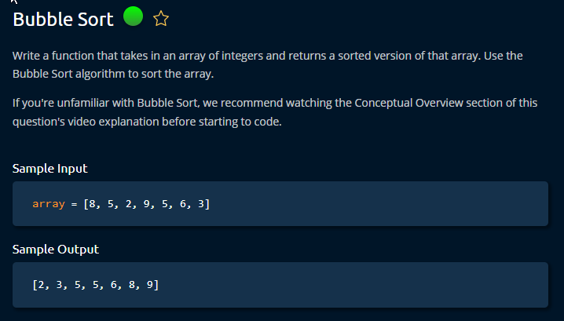

Slide 3
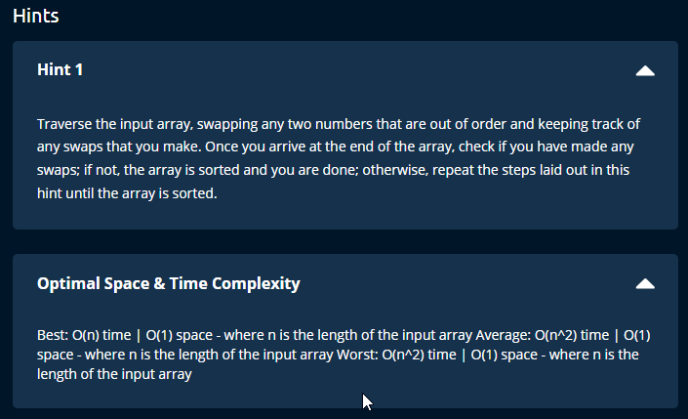

Slide 4
Notes
Time = O (n *2)
worst case scenario
Looping through the array multiple time
Time = O (n)
Best case
Space = O (1)
Steps
Simple swapping using for loop
While loop
Condition = sorted as boolean value
The loop will continue as long as one number is sorted
Using counter variable to remove the last element from the array every sort can drastically reduce the time in large arrays.

